Slide 1








Bao Buddies
Vincent Kok
Joshua Tay
Roy Ong
https://www.facebook.com/hawkerfoodgowhere
https://www.instagram.com/hawkerfoodgowhere
Junice Sim
Wendy Leong

Slide 2


Problem Statement (The Why?)
😐 Hit by Covid, some of the hawkers centers have to close for covid cleansing or periodic cleaning. Some due to lack of customers, either open late or close early - Inconsistent opening hours
😐 Many times busy working adults at CBD area walk all the way to the Hawkers, only to realize that their favorite hawkers stalls are closed or long serving time
😐 It's tiring and hot to walk all the way to find the stalls closed especially elderly with walking difficulties
😐 Tourist are not sure on the local hawkers culture and go about

Slide 3
Create a Chatbot that can …
✔️Help search out nearby hawker centres within seconds at your location(or some hawker centres nearby).
✔️ Tells you the waiting time for the stalls before you head out to the hawkers, so that you can plan your lunch time well !
✔️ Tells you the opening and closing hours of the hawker centres and stalls to avoid disappointment of not getting your favorite food!
✔️ Recommends you what to eat and at where so that you can avoid roaming around.
✔️ Provide quizzes on our local food just for fun and information for tourist to understand our local cuisines and hawker culture!

Slide 4
Our Goals
😄 Hawker stalls to have gradual improvement with business.
😄 Working adults and families to plan their lunch time, to avoid lunch time rush hours.
😄 Tourists know their way around Singapore who is known for our delicious local cuisines and hawker cultures in SG.
😄 Elderlies to have adequate information on the hawker opening and closing hours, plus the waiting time to avoid unnecessarily walking distance.

Slide 5
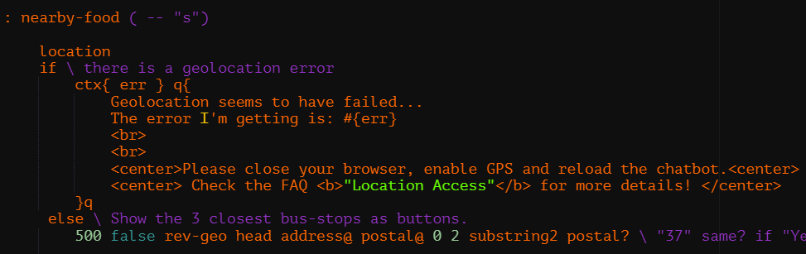
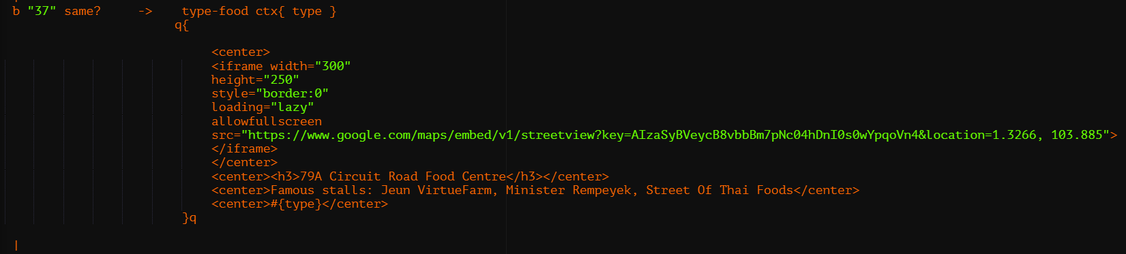
Our Technical Backend - Nearby Hawker Centre
Obtain the postal code of user’s current location (eg. “370049”). Extract the first 2 number (“37”)
Compare with database that match “37” which gives “79A Circuit Road Food Centre”

Slide 6
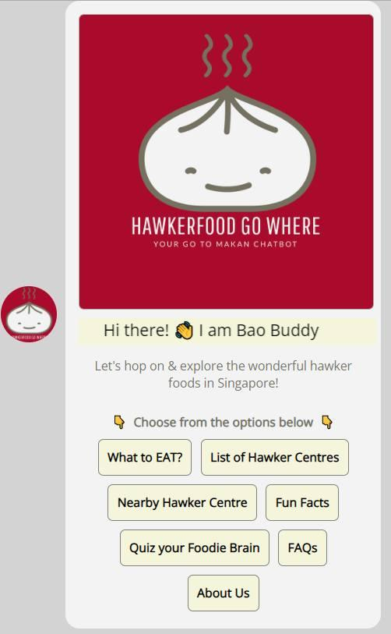
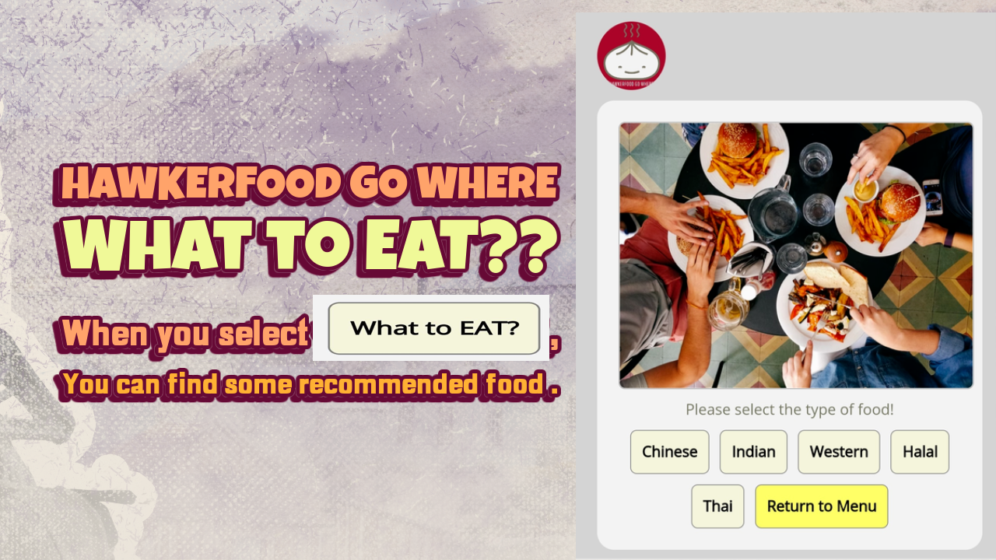
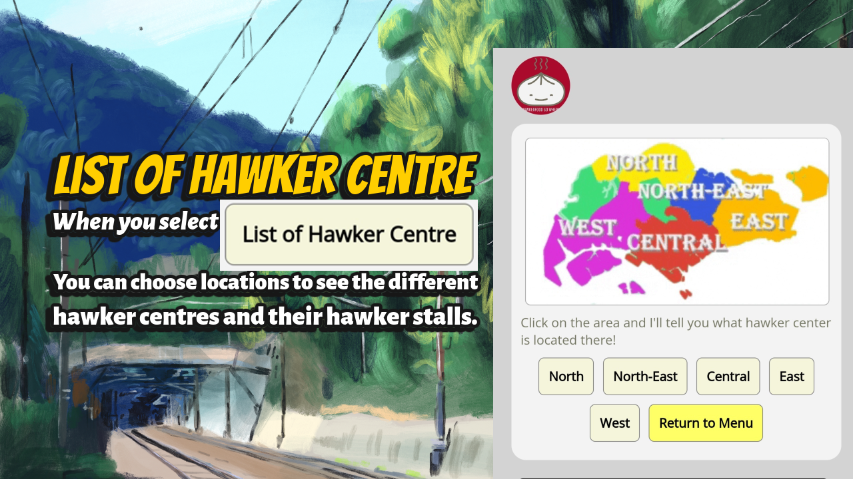
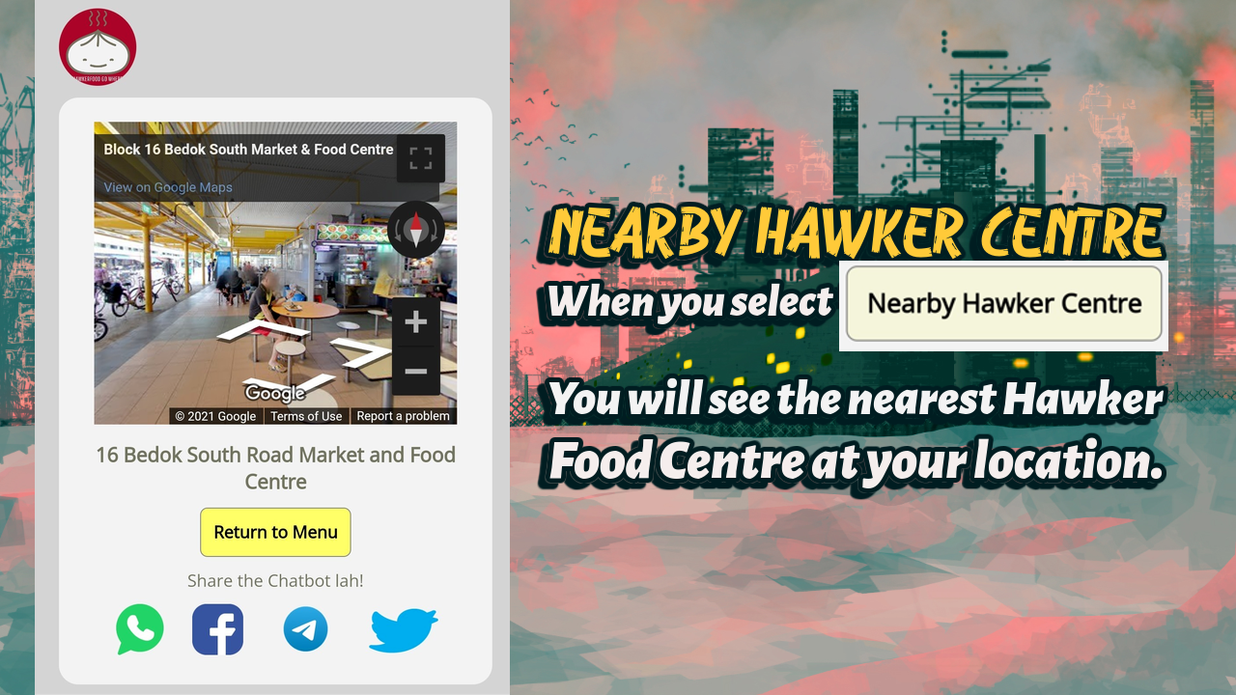
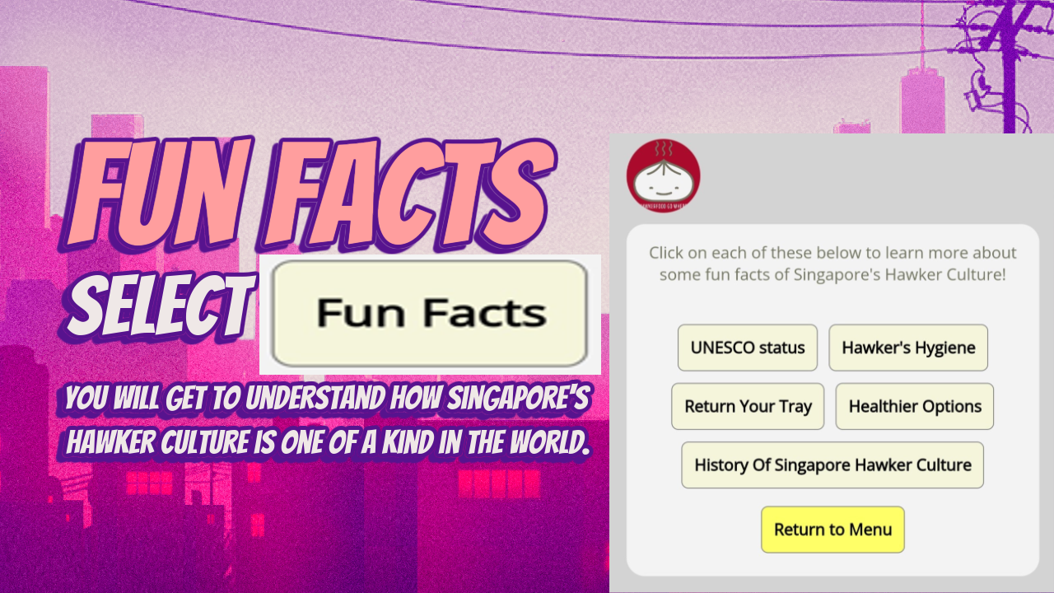
HawkerFood Go Where Chatbot (Bao Buddy)

Slide 7
Our UI / UX
😄 We thought of using “Bao”(Translate to English as “Bun”) to represent food.
😄 Bun being one of the simplest food since ancient food history and is easily recognizable.
😄 We wanted to show a color of excitement and vibrancy when it comes to food, hence we chose Red as the predominantly color.

Slide 8
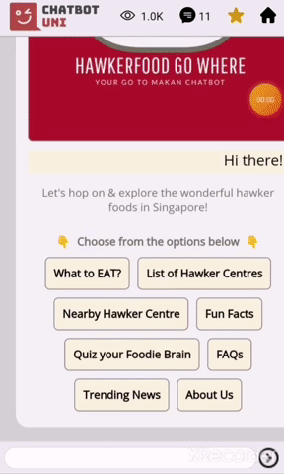
Category: What to EAT?
😄 Gives recommendation to users of what to eat.
😄 More information of the recommended stalls - signatures menu & prices
😄 Opening hours of stalls
😄 Average serving time NOW to help users to plan their visit time

Slide 9
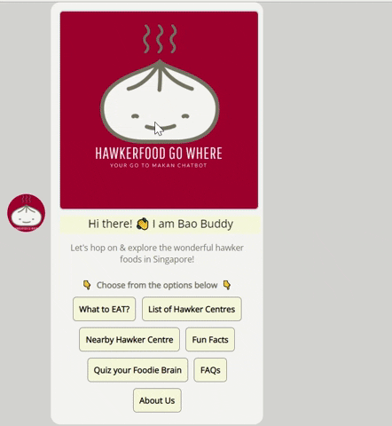
Category: List of Hawkers
😄 Allow users to choose the type of cuisines they are interested in from the list of hawkers across SG
😄 Allow the users to know whether the hawker centre is OPEN or CLOSE for scheduled cleaning
😄 To allow users to have the Google Map for easy navigation

Slide 10
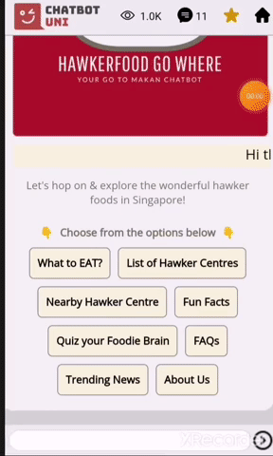
Category: Nearby Hawkers
😄 Allow users to locate any hawker centres NEARER to their location with stalls recommendations of that hawker centre
😄 Help tourists, elderlies and working adults to SAVE TIME, and plan their routes better.
😄 Provide street view for visualizing the hawker centre and map navigation

Slide 11
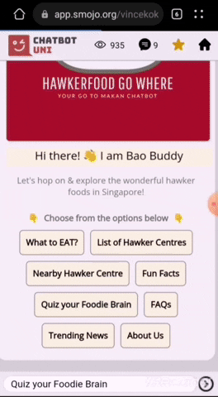
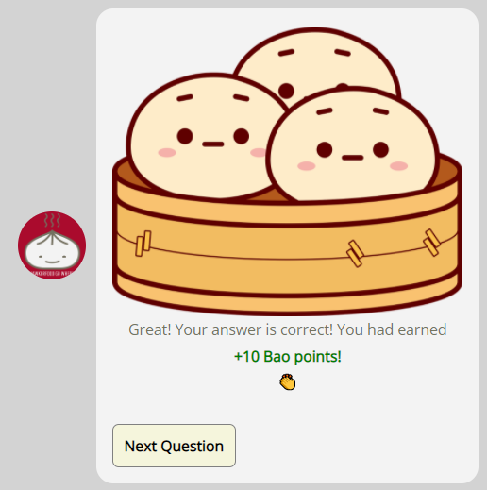
Category: Quiz Your Foodie Brain
😄 Provide quizzes on our local food just for fun (new insights and information in interactive ways)
😄 Earn Bao points for discounts

Slide 12
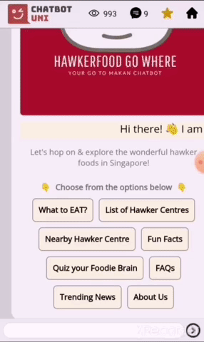
Category: Fun Facts
😄 Fun facts information for tourist to understand our local hawker culture!
😄 Informative to educate users with providing fresh, useful insights

Slide 13
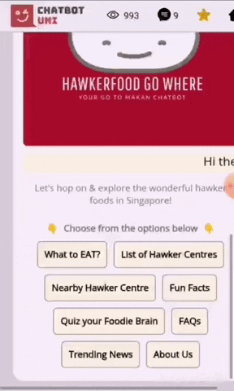
Category: FAQs
😄 Frequently Asked Questions on using the platform as well hawkers related like how to use CDC vouchers

Slide 14
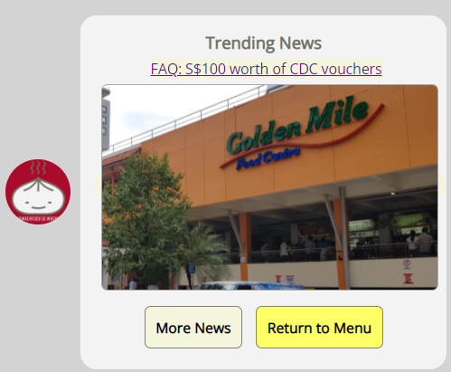
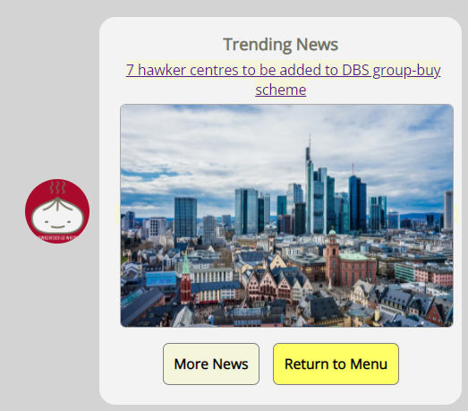
Category: Trending News
😄 Display the trending news

Slide 15
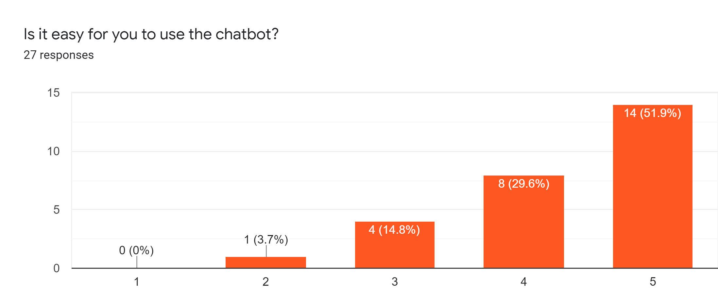
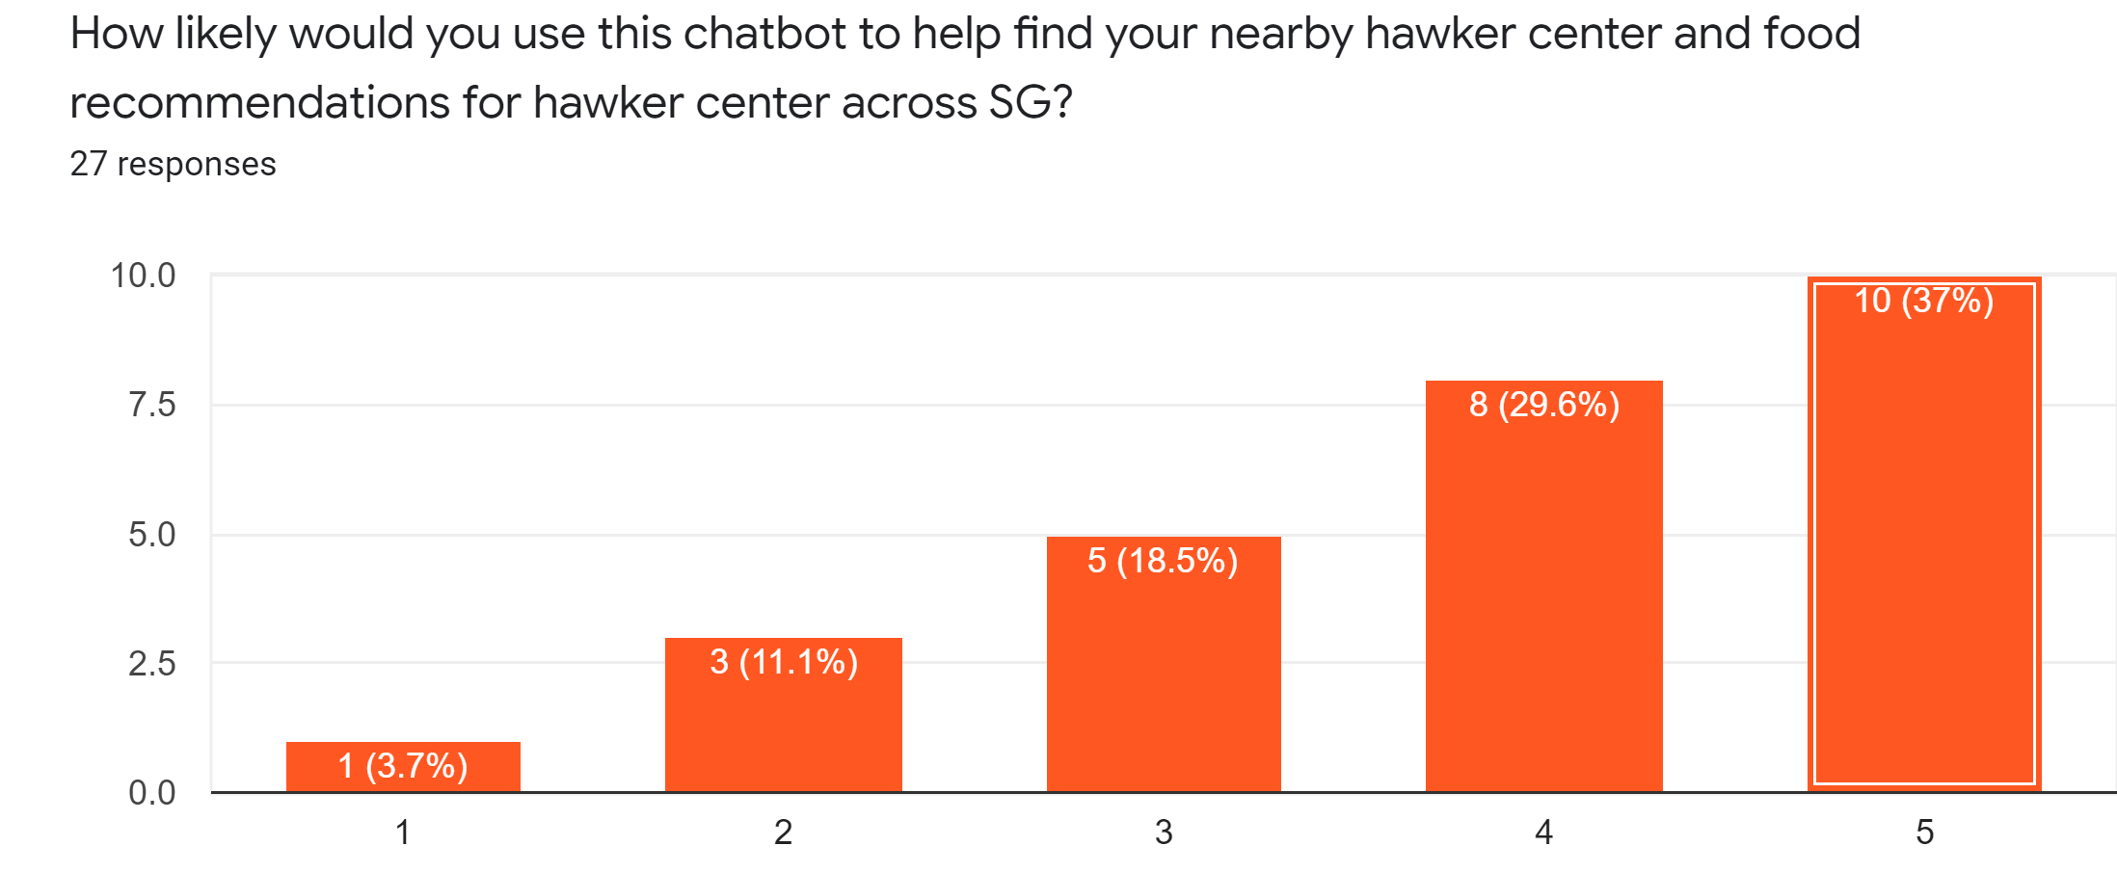
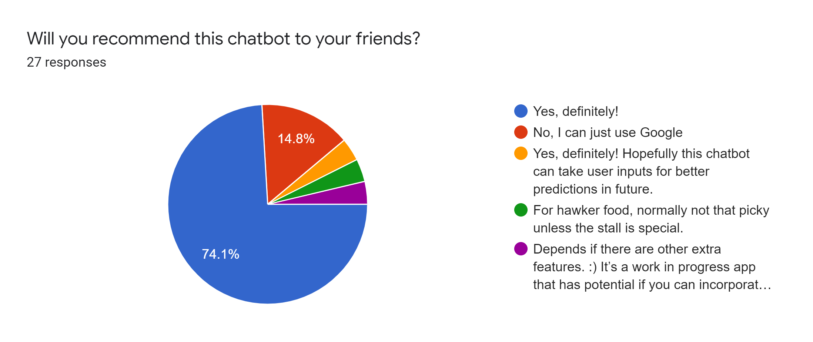
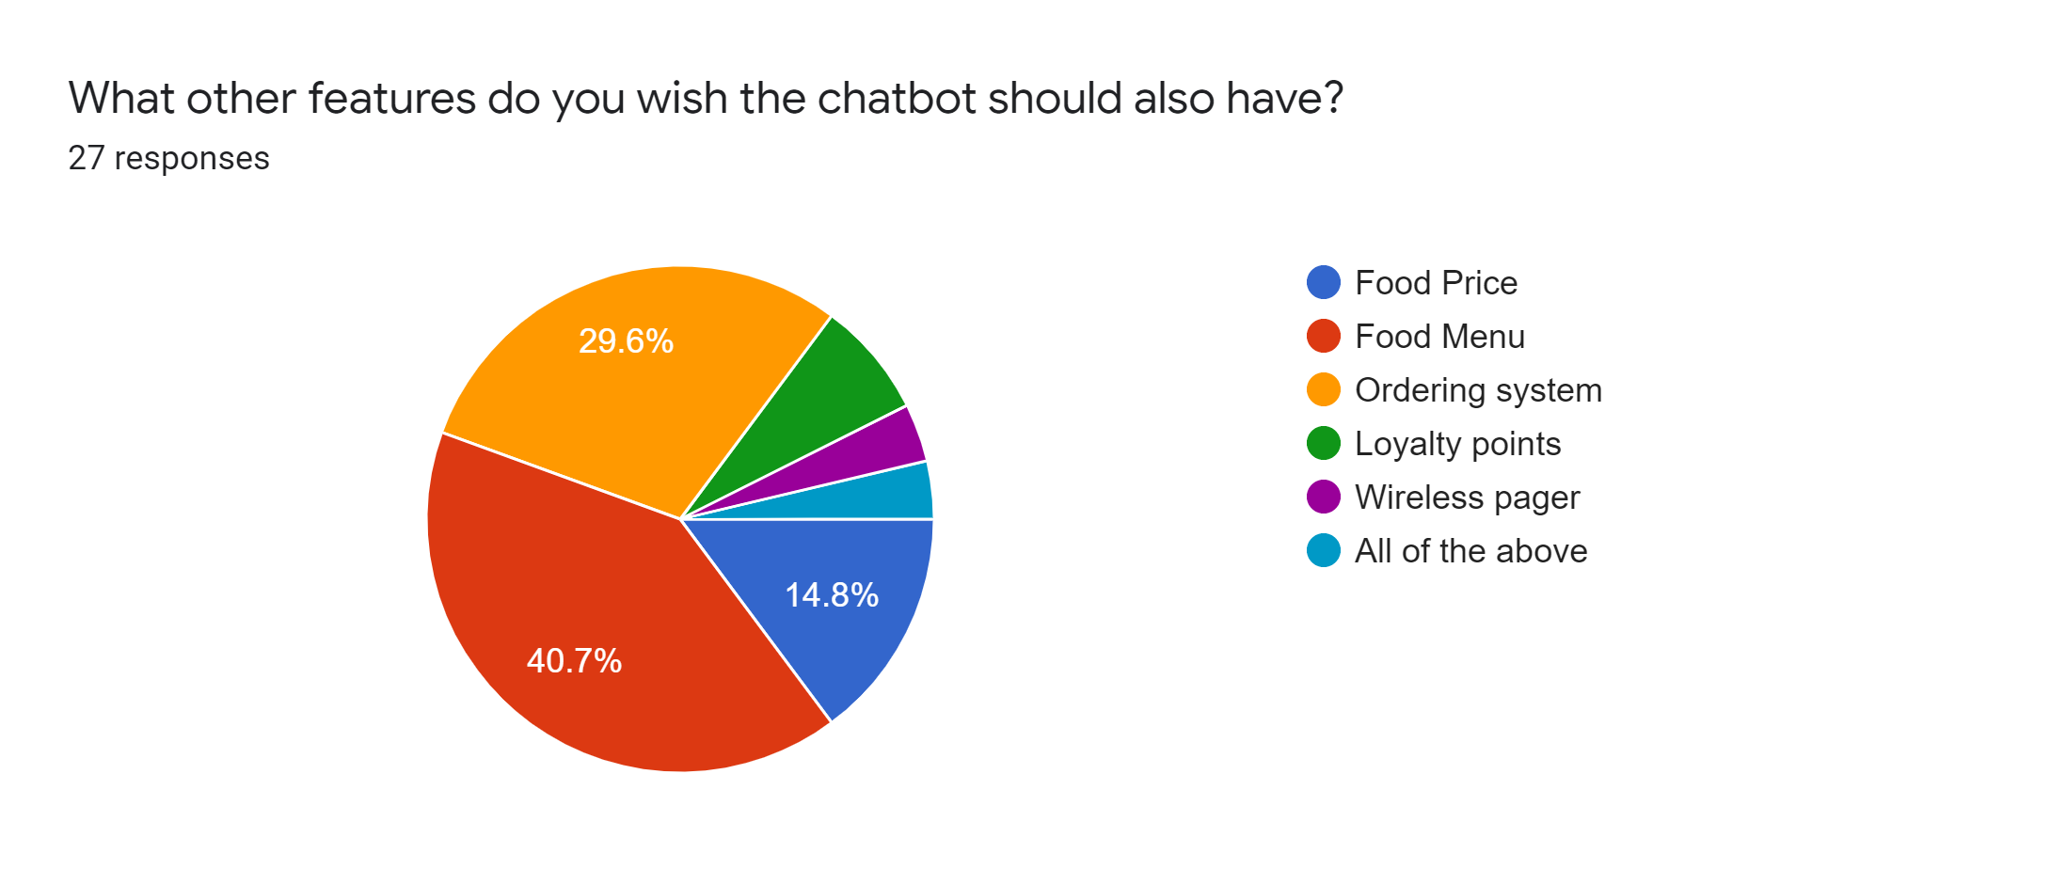
User Experience Survey
>80%
>65%
>70%

Slide 16
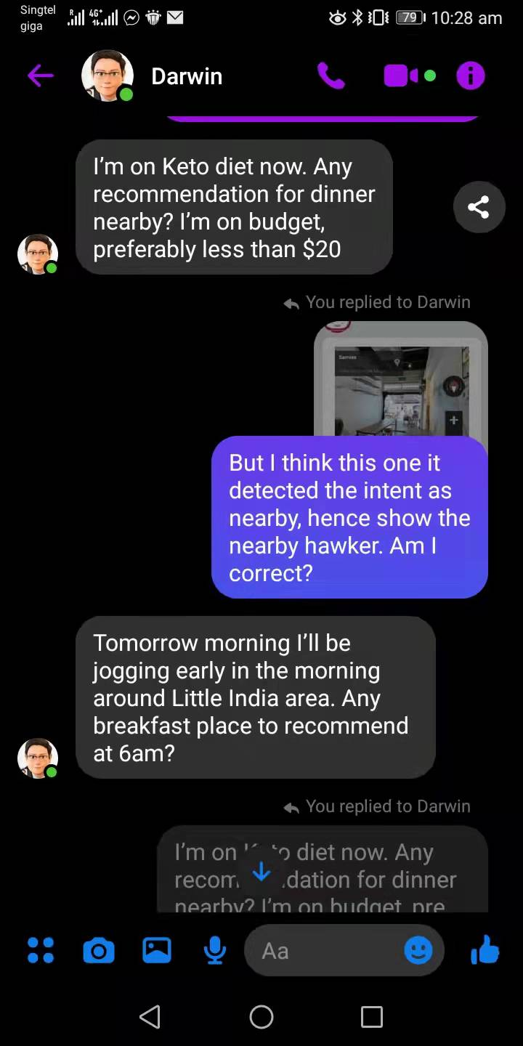
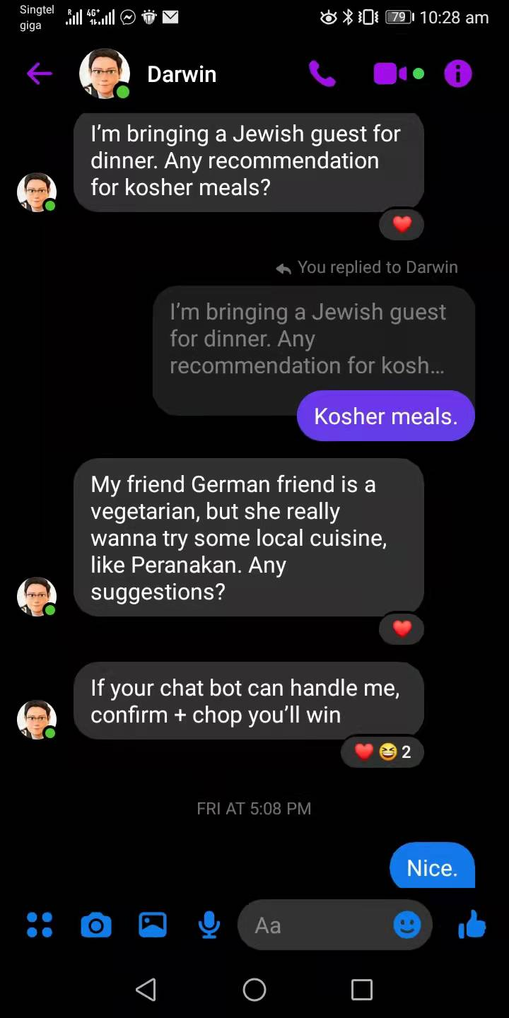
To the Future and Beyond ~ 🚀
After this challenge, we hope to push further…
📦 Food ordering and delivery
💻 Create a scanning device at all hawker stalls to determine LIVE updates of what time they are closing whether are they open or close on that day
📘 Need more than English translation for our app.
🏬 Food Discovery trail
🚀 Filter by price range as well
😄 Respond more personal and specific by analysis the input key in by users.

Slide 17
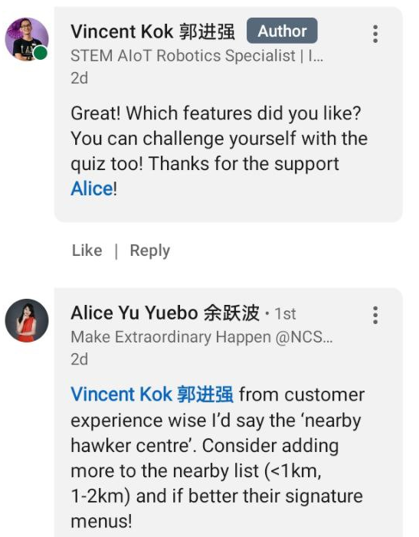
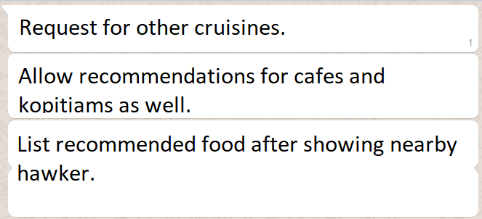
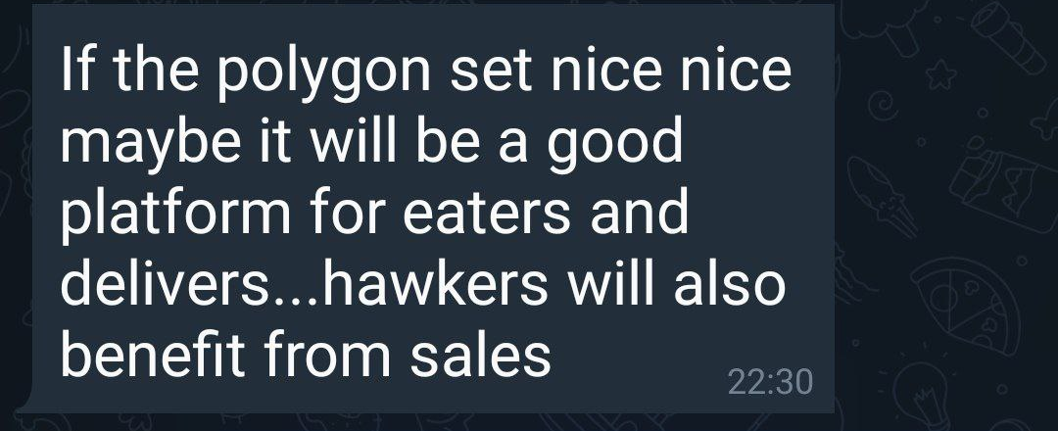
Appendix
API involved:
Hawker API: https://github.com/leejaew/api.jael.ee/blob/master/hawker.md
Rev-geo
Google Map Embed
Google Street View

Slide 18


